Slide 1
Measuring Gender Inequality and Inequality in Social Development Stephan Klasen Universität Göttingen Indices of Social Development Conference December 15, 2011
1

Slide 2
Introduction
Increasing interest in analyzing inequality (moving beyond income inequality);
Experimental and empirical evidence on the importance of inequality (plus ethical concern);
Inequality Adjusted Human Development Index;
Proliferation of Indices of gender inequality (GDI, GEM, GGI, GII, GEI, SIGI) with great differences in results;
World Bank WDR on Gender: New evidence on gender bias in mortality;
Unfortunately, many of these measures beset with important conceptual and empirical shortcomings;
Discuss problems and propose some solutions where appropriate and possible;

Slide 3
Outline
Measuring inequality in human development;
Measuring gender inequality:
Gender inequality in mortality (WDR 2012);
GDI and GEM and ways to fix them;
UNDP‘s New Gender Inequality Index;
Social Institutions and Gender Index;

Slide 4
Measuring Inequality in Human Development
Key weakness of HDI: ignores inequality within dimensions;
Innovation of HDR 2010: Inequality-Adjusted Human Development Index (IHDI)
Key idea: ‚Penalize‘ countries for inequality in each dimension of human development (education, life expectancy, and incomes);
Interesting, innovative and useful;
Two central problems:
Each inequality is considered separately; joint distribution of inequalities not considered (different data sources);
Inequality in health refers to inequalities in actual life lengths associated with an average life expectancy, rather than socioeconomic inequality in life expectancy;
Different approach (Harttgen and Klasen, 2011):
Measure human development at the household-level;
Then consider inequality in resulting HDI;
Addresses both issues (but other open questions);
4

Slide 5
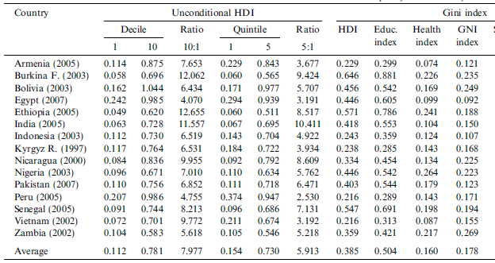
Source: Harttgen and Klasen (2011)

Slide 6
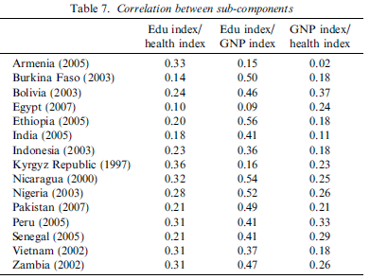
Source: Harttgen and Klasen (2011)

Slide 7
Gender Inequality Measures
Proliferation of measures;
GDI, GEM first, with many to follow;
General index problems:
Selection of relevant dimensions;
Focus on well-being, agency, underlying causes;
Aggregation issues:
Arithmetic vs geometric mean; Statistical aggregation via PCA;
Compensation between dimensions;
Specific Problems:
Internationally relevant comparable dimensions challenging;
What is the norm of ‚equality‘? Biology and preferences?
Aggregation: Problem of opposing gaps.
Gender-sensitive versus gender gap measures.

Slide 8
WDR 2012: Gender Bias in Mortality
WDR wants to calculate flow measure of gender bias in mortality: annual toll due to excess female mortality;
Comparison actual male/female mortality rate ratio with ‚standard‘ of rich countries today (Anderson, Ray, 2010);
Result: 4 million missing females per year, as many among adults as among children, as serious in Africa as in South Asia and China;
Two key problems:
Alleged excess female mortality for Africa largely by construction (data imputed based on European historical experience);
Standard from rich countries inappropriate;
If one compares with f/m mortality rate ratio of similar life expectancies, EFM much lower, mostly Asia;

Slide 9
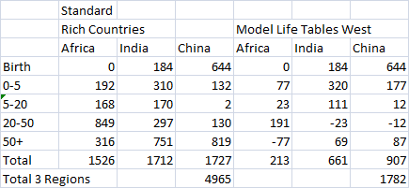
Excess Female Mortality using Different Standards
Source: Anderson and Ray (2010) and Klasen and Vollmer (2011)

Slide 10
UNDP‘s GDI
Gender-sensitive measure (HDI adjusted downwards by welfare penalty of gender inequality);
Many problems
Often misinterpreted;
Problem of compensation between dimensions;
Problem with earned income component:
What is the norm?
Gender inequality in earnings not equal inequality in consumption
Serious data problems (uniform assumptions)
Possible corrections (Klasen and Schüler, 2011):
Male and Female HDI
Turn GDI into Gender Gap Measure

Slide 11
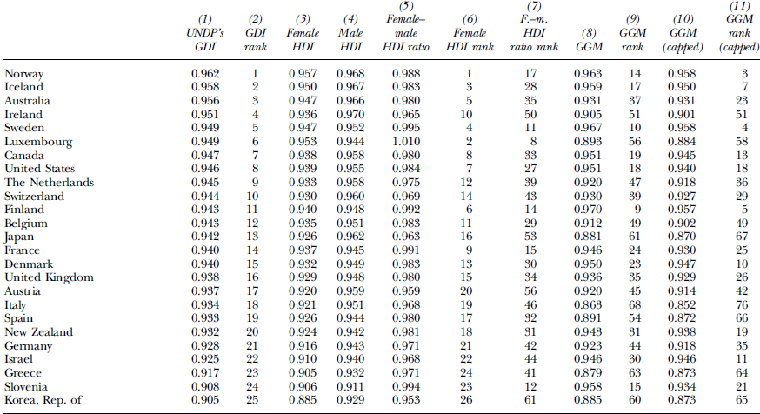

Slide 12
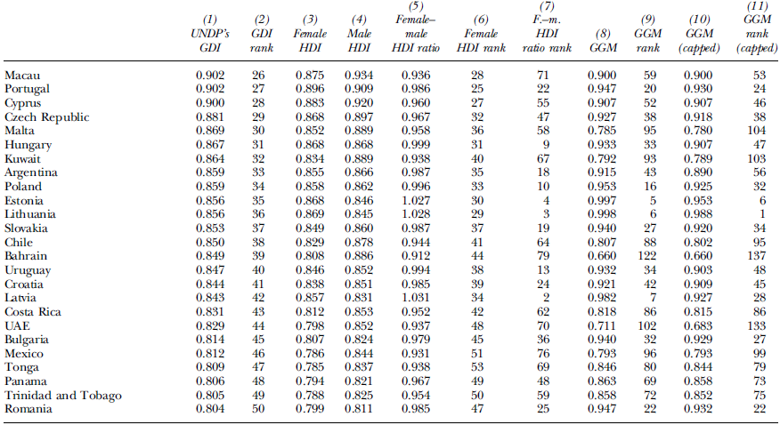

Slide 13
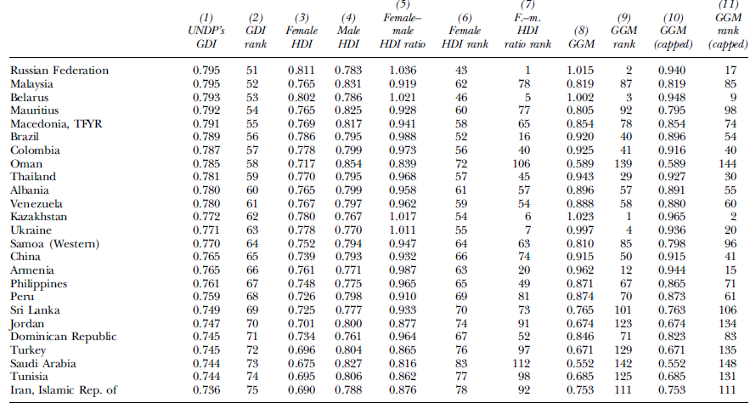

Slide 14
Gender Empowerment Measure
Measures inequality in economic and political participation and power;
Some Problems:
Data availability;
Focus on elites?
Compensation issue?
Income component: gender-inequality adjusted levels of incomes; levels, rather than gaps drive results!
Can partly be corrected (using income shares rather than rates).

Slide 15
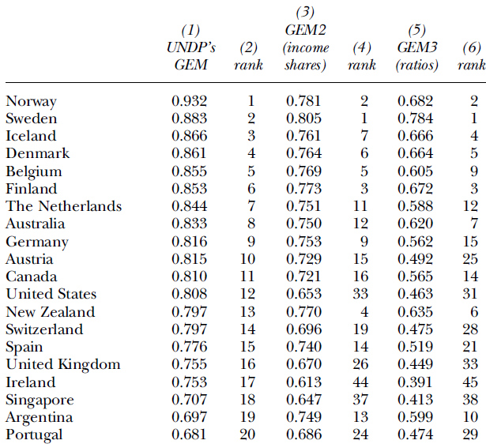

Slide 16
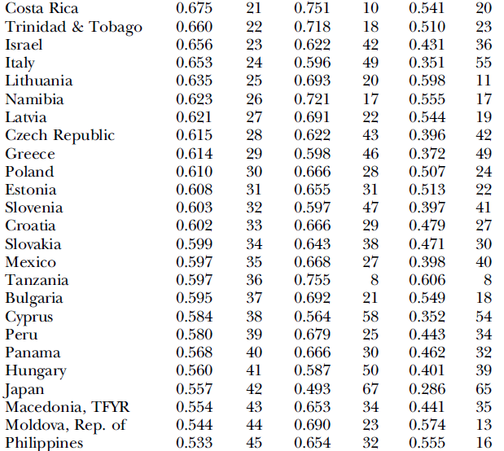

Slide 17
UNDP‘s Gender Inequality Index
Measures welfare penalty due to gender inequality (kind of gender gap index)
5 components: labor force participation, secondary education, teenage pregnancy maternal mortality, parliamentary seats;
Full of problems:
Intransparent, highly complicated, hard to interpret;
Mixes well-being and empowerment;
Mixes achievements with gaps;
No link to HDI;
Hard to fix.

Slide 18
Other Measures
World Economic Forum ‚Gender Gap Index‘:
Clear gender gap measure
Mixes well-being and empowerment;
Too many components and not inter-temporally comparable;
Only use of gaps
Social Watch Gender Equity Index:
Far too many components to interpret;
Mixes well-being and empowerment;
Unclear database;
Compensation issue;

Slide 19
OECD‘s Social Institutions and Gender Index
Based on OECD Gender and Institutions Database (Branisa, Klasen, Ziegler, 2009)
Aims to measure institutional causes of gender inequality (not outcomes but ‚inputs‘); (use as instrument)
14 indicators in 5 dimensions: family code, physical integrity, civil liberties, son preference, ownership rights;
Based on subjective scoring (of laws and prevalence);
PCA to aggregate within dimensions, partial compensation between dimensions;
Can explain important development outcomes (including fertility, child mortality, education, corruption);
Problems:
Only cross-section and unclear how to think about dynamics;
Only developing countries;
Mixes prevalence, laws, etc;

Slide 20
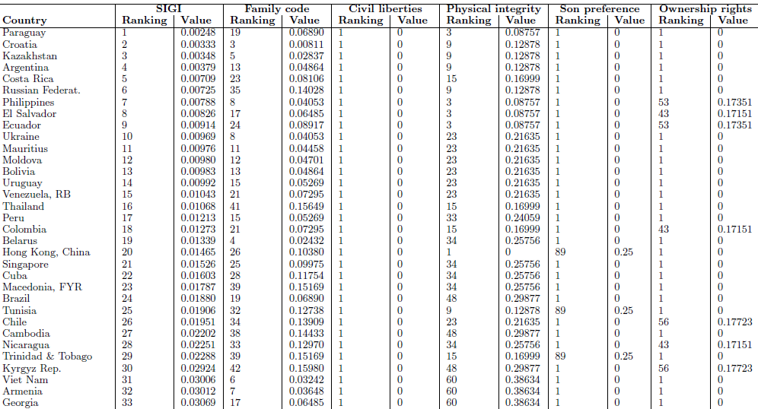

Slide 21
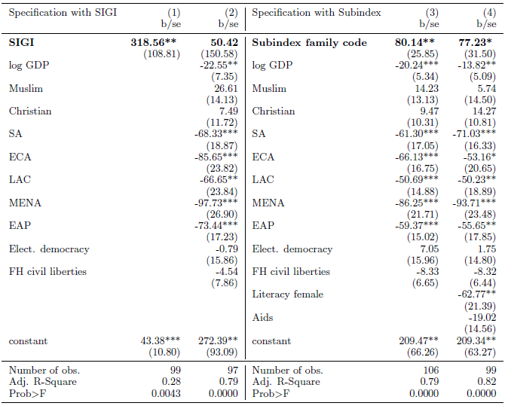

Slide 22
Conclusions
Increasing recognition to measure and interpret inequality, including gender inequality;
Composite indices of gender inequality require particular care;
Many of current measures have serious problems, some of which can be fixed;
Examining individual dimensions rather than composite measures might be more useful;
Interesting new approaches (including SIGI and ISD) to broaden scope of measuring inequality which help to better understand causes of persistent inequalities in outcomes;

